Slide 1


School of Computing Science and Engineering
Topic: HOME AUTOMATION
Enrollment Number 21SCSE1011575
Name1: JAPTAVYA SINGH
Enrollment Number2: 21SCSE1011559
Name2: SAMARTH KHATRI
Enrollment Number3: 21SCSE1011576
Name3: VISHAL BHARTI
Enrollment Number4: 21SCSE1011570 REVIEWER NAME: Mr. BALDIVYA KIRTI
Name4: ANAND KUMAR GUIDE NAME: Mr. NITIN JAIN
GROUP ID: BT2505
Program Name:B.Tech(CSE)

Slide 2
Literature Review on Home Automation System
Automation performs an increasingly vital role in daily experience and global economy. Engineers strive to combine automated devices with mathematical and organizational tools to create complex systems for a rapidly expanding range of applications and human activities.
The concept of home automation has been around since the late 1970s. But with the enhancement of technology and smart services, people’s expectations have changed a lot during the course of time to perfectly turn the traditional house into smart home, and also think that what a home should do or how the services should be provided and accessed at home to became a smart home and so has the idea of home automation systems.
Program Name: B.Tech (CSE)

Slide 3
Challenges of Home automation systems
Home automation systems suffers four main challenges; these are poor manageability, inflexibility, difficulty in achieving securityand high cost of ownership,The main objectives of this research is to design and implement a home automation system using IoT that is capable of controlling and automating most of the house appliances through an easy manageable web interface. The proposed system has a great flexibility by using Wi-Fi technology to interconnect its distributed sensors to home automation server. This will decrease the deployment cost and will increase the ability of upgrading, and system reconfiguration.
Program Name: B.Tech (CSE)

Slide 4
Abstract
Current there is no specific model or project which can completely automize all the electrical appliances in our houses. If there are some models for this in the market, then they are not cost effective. So basically we are here trying to make the lifestyle of the customer very convenient and specially it can be a boon for the specially challenged peoples.
Here we are automating all the electrical appliances in our homes just with the help of one voice command. We convert house into a smart house by giving control on your smartphone/tablet and touch panels .You can control lighting, curtains,home cinema, media servers, surveillance, climate control, back ground music, we customize just as per your taste and design. Our Home automation give you control of Climate, Security,Equipment, Lights, camera, projector, tv, projection screen, window drapes, conferencing unit, with options of adding sensors to create scenes as per your mood and requirement.
Program Name: B.Tech (CSE)

Slide 5
In our prototype we have used the following tools:
Arduino Uno
2 Channel Relay
BT Voice command
Breadboard
DC Motor
LED
Home automation has high potential for sharing data between family members or trusted individuals for personal security and could lead to energy saving measures with a positive environmental impact in the future. We have successfully achieved
Our objective of automizing our houses.
Program Name: B.Tech (CSE)

Slide 6
There are several new technologies which can become a part of home in the near future:
• Increased efficiency, control, and customization
• Integration of Smart home devices
• Development of smart appliances
Program Name: B.Tech (CSE)

Slide 7
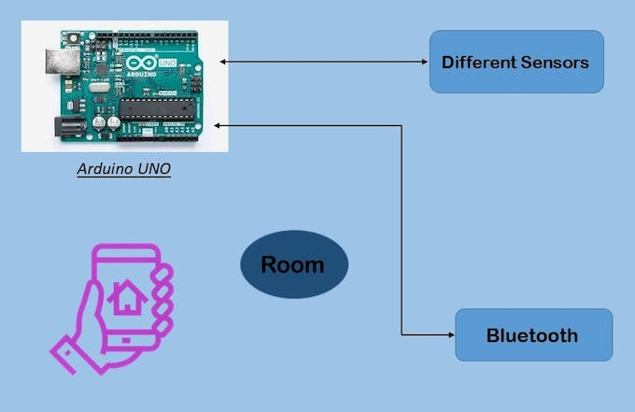
Introduction
In today's era, technology can enhance human life. Technology is evolving decade by decade. Automation was a science fiction earlier but not today. By combining latest technology with home, we can build an awesome home. With the Arduino uno and Windows 10, we can build a home automation system that is capable of operating home devices automatically.
Program Name: B.Tech (CSE)

Slide 8
Tool and Technology Used
In our prototype we have used the following tools:
Arduino Uno
2 Channel Relay
BT Voice command
Breadboard
DC Motor
LED
Program Name: B.Tech (CSE)

Slide 9
Literature Survey
In Bluetooth based home automation system the home appliances are connected to the Arduino BT board at input output ports using relay. The program of Arduino BT board is based on high level interactive C language of microcontrollers; the connection is made via Bluetooth. The password protection is provided so only authorized user is allowed to access the appliances. The Bluetooth connection is established between Arduino BT board and phone for wireless communication. In this system the embedded C is used and it can install on any of the Symbian OS environment, it is portable.
Program Name: B.Tech (CSE)

Slide 10
CONCLUSION
Survey of different home automation system shows that there are various kinds of technologies used to implement this type of system. All the proposed systems have been presented and compared in this paper which reveals some merits and demerits of the systems. This review explained different home automation system e.g. Web based, Bluetooth-based, mobile-based, SMS based, ZigBeebased, Arduino microcontroller based, Android app based, IOT based and cloud-based. Due to its performance, simplicity, low cost and reliabilityhome automation system is making its position in global market,that day is not so far when every home will be the smart home.
Program Name: B.Tech (CSE)

Slide 11
REFERENCES
[1] Yadnya Adhiya, Shriya Ghuge, H.D Gadade “A survey on home automation system using IOT” IJRITCC Volume_5_IssuesMarch_17_Volume_5_Issue_3
[2] Kim Baraka, Marc Ghobril, Sami Malek, RouwaidaKanj, AymanKayssi “Low cost Arduino/Android-based Energy-Efficient Home Automation System with Smart Task Scheduling”, 2013 Fifth International Conference on Computational Intelligence, Communication Systems and Networks.
Program Name: B.Tech (CSE)

Slide 12


